Slide 1


Inclusive Education: Research & Practice
Jess Whitley
Brockville and District Association for Community Involvement
uOttawa.ca
Notes:
9:15-10:30
Intro/welcome – 2 minutes
Inclusion Activity – 2-3 minutes
Jess Input – 5 minutes
Activity – 15 minutes
Jess Input – 15 minutes
Identity Activity – 3-5 minutes
Andy Identity – 15 minutes
& Lego Wrap Up – 5 minutes (~ 65 minutes)

Slide 2
Does It Work?
Notes:
On their own – brainstorm or just reflect/think – term in general.
Give 1 minute for this
Then ask – what if I’d said “Inclusive Education” – would your answer have been different? The same? Can we take up a few answers?

Slide 3
What is It?
Notes:
On their own – brainstorm or just reflect/think – term in general.
Give 1 minute for this
Then ask – what if I’d said “Inclusive Education” – would your answer have been different? The same? Can we take up a few answers?

Slide 4
Education of students with special needs that does not take place in a segregated class or school
A process of systemic reform embodying changes and modifications in content, teaching methods, approaches, structures and strategies in education to overcome barriers with a vision serving to provide all students of the relevant age range with an equitable and participatory learning experience and environment that best corresponds to their requirements and preferences.
A commitment to ensuring a high-quality, culturally and linguistically responsive and equitable education to support the well-being and achievement of every student.
A sense of belonging to a class and school and social acceptance by peers and a more individualized curriculum.
A pairing of philosophy and pedagogical practices that allow each student to feel respected, confident and safe so he or she can learn and develop to his or her full potential.
The presence of two or more students with special needs in a classroom.
The commitment to include students with special educational needs in mainstream education by improving and adapting specific classroom practices to the individual needs of the learner where students should not only be physically integrated but also socially included.
Placing students with disabilities within mainstream classes with appropriate adaptations
Students with disabilities spending 50% or more of their day w/ same aged peers

Slide 5

INCLUSIVE
SEGREGATED

Slide 6
Krämer et al., 2021
Szumski et al., 2017
40 studies
47 studies
Cognitive/Intellectual Disabilities
Range of students w/ mild-moderate SEN
N = 11,987
N = 4,800,000
+ w/ Disabilities - Academics
* w/ Disabilities - Psychosocial
* No Disabilities – Academic & Psychosocial
+ w/ Disabilities - Academics
+ No Disabilities - Academic
‘Severe’ vs. Mild/Moderate
++ @ Elementary

Slide 7
Does It Work?
How Does It Work Best?

Slide 8
Structures & Processes
School Climate
School Leadership
Pedagogy & Assessment
Organization of Specialist & Support Services
Collective Efficacy
Partnerships & Collaboration
Ongoing Professional Learning

Slide 9



Slide 10
Leadership for Inclusive Education

Slide 11




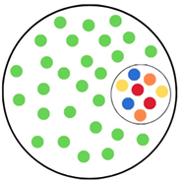

Inclusive Ed
IE
IE
IE
IE
Notes:
inclusive education, if we were to look at the Inclusive Education word umbrella, it should be at the top of our system. In everything we do. All Policies, all procedures, all systems, all operations would fall under that. (Teacher)

Slide 12
Collaborate with other administrators in implementing the Policy
.49
Inclusive Education Continuum
Establish opportunities for teachers collaborate and dialogue about the needs of their students and themselves
.45
Notes:
Top correlations between where they’re at with implementation & support/resources/autonomy
.49 (admin) .45 (teachhers)

Slide 13


Slide 14
Perceived Inclusive Education Impact
Notes:
Ask them – what do they see? how do they interpret/make sense of it?
Administrators – neutral/negative on workload – more positive about impact on students
Overall – across staff groups – highest was relationship between schools & families

Slide 15
Teaching for Inclusive Education

Slide 16
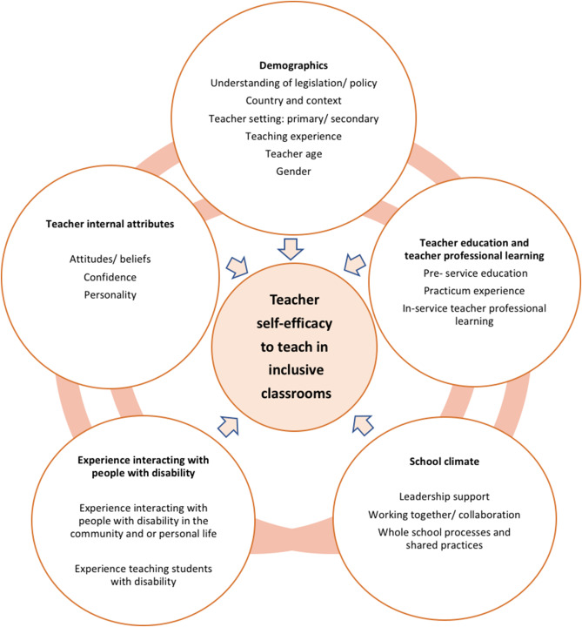
Wray, Sharma &. Subban, 2022
Notes:
Wray, E., Sharma, U., & Subban, P. (2022). Factors influencing teacher self-efficacy for inclusive education: A systematic literature review. Teaching and Teacher Education, 117, 103800.

Slide 17
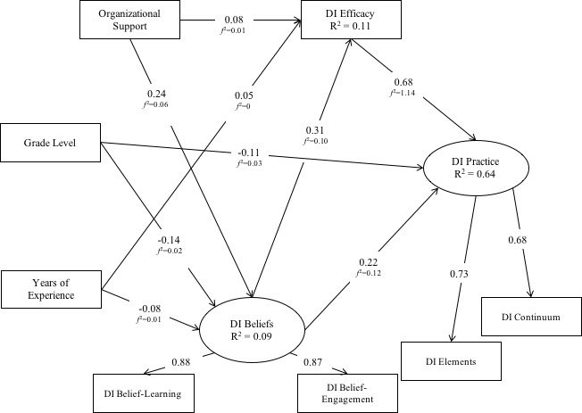
Whitley et al., 2019
N=4875 Ontario Teachers

Slide 18
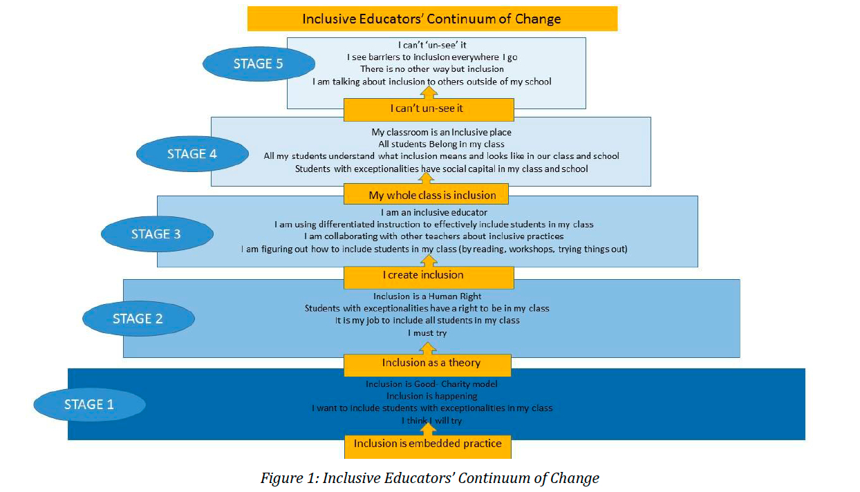
Somma & Bennett (2020)
Notes:
Somma, M., & Bennett, S. (2020). Inclusive Education and Pedagogical Change: Experiences from the Front Lines. International Journal of Educational Methodology, 6(2), 285-295.

Slide 19
Supporting for Inclusive Education

Slide 20
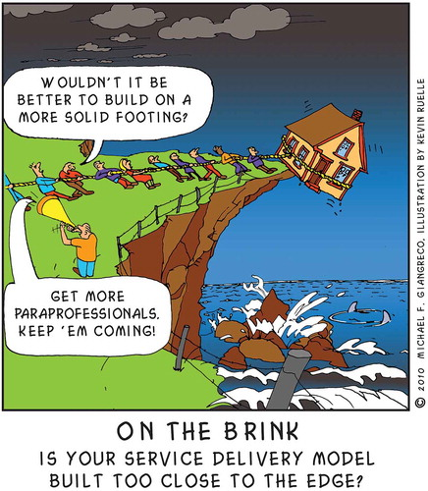

‘I suppose it is tempting, if the only tool you have is a hammer, to treat everything as if it were a nail.’ (Maslow, 1966)
Notes:
Giangreco, M. F. (2021). Maslow’s hammer: Teacher assistant research and inclusive practices at a crossroads. European Journal of Special Needs Education, 36(2), 278-293.

Slide 21
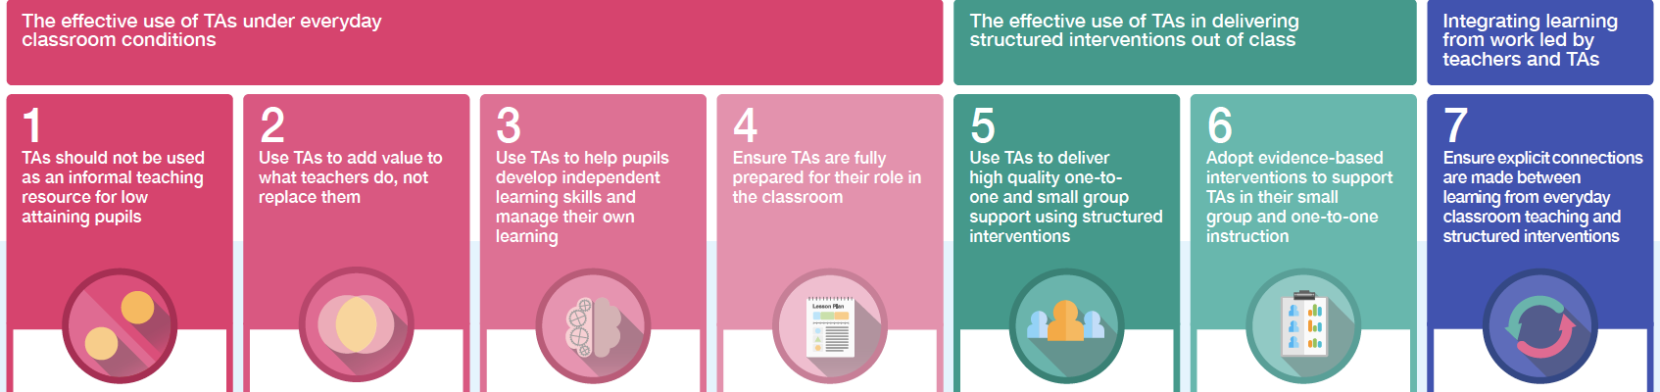
Promising Practices
Listen to students
Assign EAs to teachers
Match need to support

